Slide 1

Food Consumption Patterns & CO₂ Emissions
Group 3 Members:
Chen Yiman | Shi Chee Liang
Lim Ming Jie Anne | Tan Hui Wen
Sherinah Rashid | Tan Zexeong

Slide 2
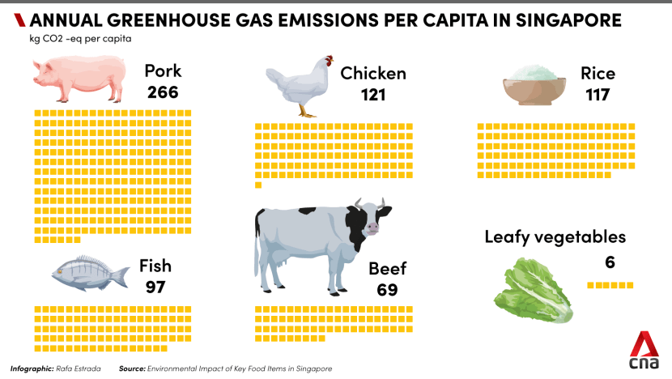
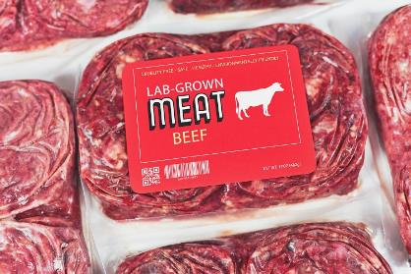
On an individual level, a person’s food consumption pattern contributes to a significant proportion of a person’s overall greenhouse gas (GHG) impact
Clune et al., (2017) highlighted that:
Substituting Meats with… | Results in…
Alternative meats | 30% reduction in GWP*
Alternative plant and fish-based diet | 52% reduction in GWP*
Source: CNA
Note:
Red meats → 11% of food consumed by weight, but contributed approximately 40% of GHG emissions
Pork → 6% of food consumed by weight, but 28% of food GHG emissions
*GWP = Global Warming Potential : Allow comparisons of the global warming impacts of different gases.
Notes:
https://www.researchgate.net/figure/GLOBAL-WARMING-POTENTIAL-GWP-FOR-SELECTED-GREENHOUSE-GASES-GHG_tbl1_295513432
Global Warming Potential : Allow comparisons of the global warming impacts of different gases.
CO₂, by definition, has a GWP of 1 regardless of the time period used, because it is the gas being used as the reference.
CO₂ remains in the climate system for a very long time: CO₂ emissions cause increases in atmospheric concentrations of CO₂ that will last thousands of years.

Slide 3
Objective: Exploratory Modelling
Changing our food consumption patterns will have an impact on greenhouse gas emissions.
HPB optimal diet: 50% fruit and vegetables, and 25% wholegrains and protein (meat and others)
‘30 by 30’ target: Produce 30% of nutritional needs locally by 2030*
Considerations for
our modelling
*At the point of the launch of the target, the target was 10% for both eggs and fish, and 20% leafy vegetables.

Slide 4
Influence Diagram
Optimal health diet 50% fruits & veg, 25% grains, 25% meats
Constraint
Food Consumption Ratios of various food types
Food consumed per food type (in kg) per capita in Singapore
Total food consumed (in kg) per capita in Singapore
GHG emissions per capita from food consumption in Singapore
Amount of food acquired from each country by type (fresh, chilled, frozen)
GHG emissions per kg of food from production
Average GHG emission per kg per food type in Singapore
GHG emissions per kg of food from processing
GHG emissions per kg of food from transportation
Parameters
Decisions
Consequence variables
Performance Measure

Slide 5
Assumptions for Analysis
1. The following factors will not be considered for imports:
2. GHG emissions per-capita & total annual food consumption per capita will remain constant up to 2030.
Food pricing will have no impact on the analysis.
Countries are assumed to have sufficient resources and are willing to sell.
It will be assumed that each import country’s offerings of food types or produce for export to Singapore will not change.
3. Singapore will achieve the 30 by 30 goal, and Singapore residents will support and consume local produce regardless of pricing or preference.
4. Only data on food types from countries that make up around 80% of total foods will be used.

Slide 6
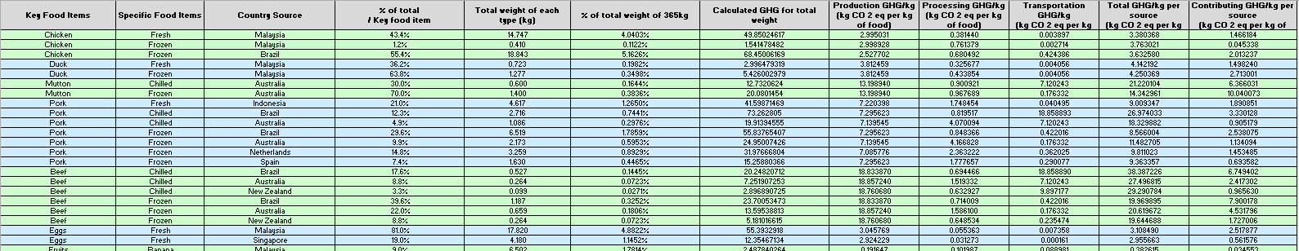
Computation & Analyses Performed – Input Model
The raw data comprised information from 2018, with all GHG emissions provided in units of kg CO₂-equivalent:
Total food consumption = 365kg per capita
Key food items | Type of food – chilled, fresh, frozen | Country source | % of total consumption per key food item
Production GHG/kg | Processing GHG/kg | Transportation GHG/kg | Amount of food consumed
Sum
Total GHG per kg per source
Multiply
Contributing GHG per kg per source
Raw Data
Total Weight of each type =
% of total consumption* Amount of food consumed
% of total weight =
Total Weight of each type / 365
Calculated GHG for total weight = Total weight of each type* Total GHG/kg per source

Slide 7
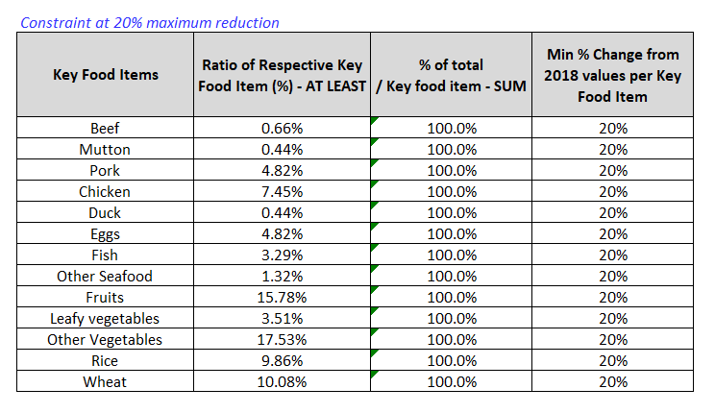
Data Model
For each food item, ∑Contributing GHG per kg per source
∑ % of total weight of each type
Key Food Items | Ratio of Respective Key Food Item (%) | Amount of Key Food Item Consumed (kg) | Average GHG Emission per kg of Key Food Item (kg CO 2 eq per kg of food) | Total GHG Emission per Key Food Item (kg CO 2 eq)
Beef | 0.82% | 3.0 | 24.29 | 72.87
Mutton | 0.55% | 2.0 | 16.41 | 32.81
Pork | 6.03% | 22.0 | 11.95 | 262.80
Chicken | 9.32% | 34.0 | 3.52 | 119.84
Duck | 0.55% | 2.0 | 4.21 | 8.42
Eggs | 6.03% | 22.0 | 3.08 | 67.75
Fish | 4.11% | 15.0 | 5.52 | 82.84
Other Seafood | 1.64% | 6.0 | 5.26 | 31.57
Fruits | 19.73% | 72.0 | 0.40 | 29.15
Leafy vegetables | 4.38% | 16.0 | 0.42 | 6.80
Other Vegetables | 21.92% | 80.0 | 0.82 | 65.53
Rice | 12.33% | 45.0 | 2.57 | 115.79
Wheat | 12.60% | 46.0 | 0.72 | 33.24
A min value of 20% was included to ensure that the ratio of food items from 2018 would REDUCE no more than 20% in 2030
Ratio of food items for 2030 was computed by multiplying 80% to the original ratio of food items in 2018, and set as minimum values.
To further ensure that all the food sources will remain as is to ensure food diversity, a minimum value of 1% was set per food item.
Multiply

Slide 8
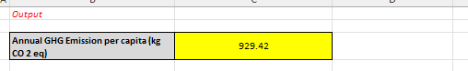
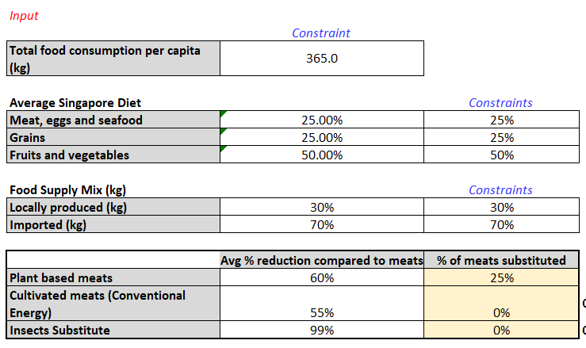

Computation & Analyses Performed
Input Model (2018)
Baseline Model (Optimal Health)
Scenario 1 – Optimal Health + 30 by 30
Scenario 2 – Scenario 1 + Alternative Meats
Output Variable
Input Values
Decision Variables
Solver Parameters
For Baseline & Scenario 1
Fields | Values
Objective Cell | Annual GHG Emission per capita
By Changing Variable Cells | Percentage of Respective Key Food Item or percentage of food from each source
Constraints | Quantity of food consumed per capita remains unchanged at 365kg across all scenarios Food supply Import = 70% in line with 30 by 30 target Local = 30% in line with 30 by 30 target HPB optimal diet Meat, eggs, seafood = 25% Grains = 25% Fruits & vegetables = 50% All % of food sources must add up to 100% All food sources contribution can only be reduced by up to a maximum of 20% All food sources must contribute to at least 1% of each food type
The decision variables were tweaked as necessary based on the respective model
Based on the raw and derived data, the calculated GHG emissions was 929.42 kg CO2-eq

Slide 9
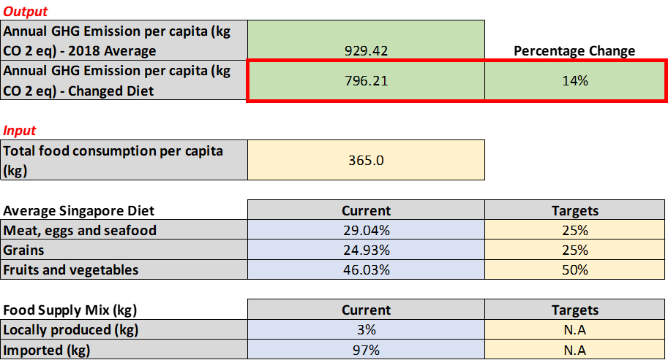
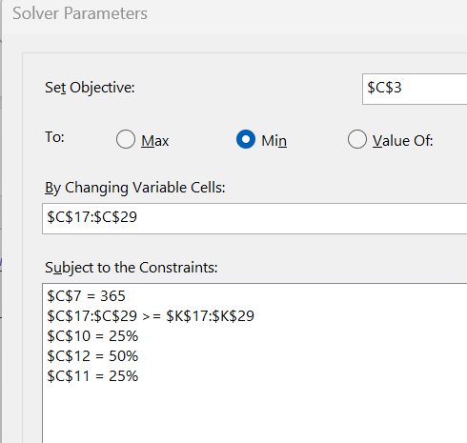
Baseline : Dietary Change to HPB’s optimal diet
Input Model (2018)
Baseline Model (Optimal Health)
Scenario 1 – Optimal Health + 30 by 30
Scenario 2 – Scenario 1 + Alternative Meats
How can changing our diets impact GHG emissions?
GHG Emission per capita
NEW Ratio of Respective Key Food Item (%)
Constraints:
HPB diet
Minimum values for ratios
Constant food consumption
For the baseline model, the calculated GHG emissions was 796.21 kg CO2-eq
→ 14% decrease!

Slide 10
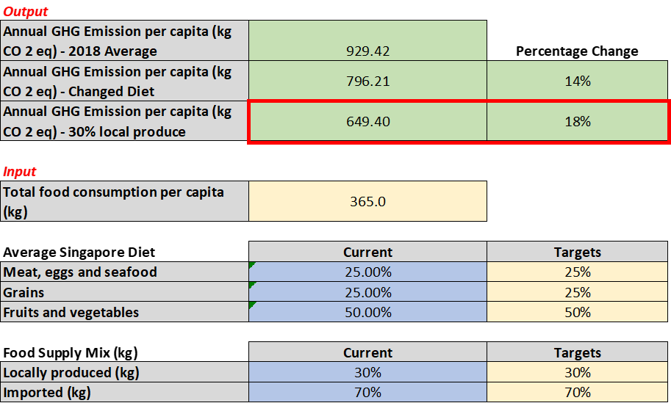
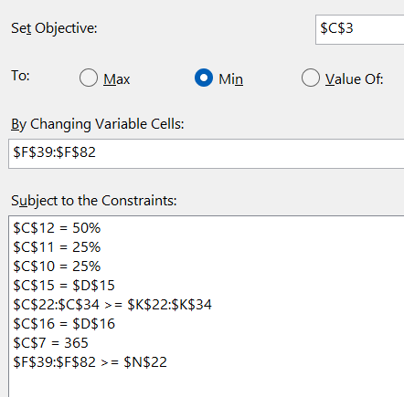
Scenario 1: Baseline + 30 by 30
Input Model (2018)
Baseline Model (Optimal Health)
Scenario 1 – Optimal Health + 30 by 30
Scenario 2 – Scenario 1 + Alternative Meats
How does food production policies impact GHG emissions?
GHG Emission per capita
% of total consumption per key food item
Constraints:
HPB diet
Food supply = 30-70
Minimum values for ratios
Constant food consumption
Min of 1% per food item
For the baseline model, the calculated GHG emissions was 649.4 kg CO2-eq
→ Further 18% decrease from Baseline!

Slide 11
Let’s look at the Ratio of the Food Items…
Key Food Items | Original Ratio of Respective Key Food Item (%) | NEW Ratio of Respective Key Food Item (%) | Difference (After – Before)
Beef | 0.82% | 0.66% | -0.16%
Mutton | 0.55% | 0.44% | -0.11%
Pork | 6.03% | 4.82% | -1.21%
Chicken | 9.32% | 7.45% | -1.86%
Duck | 0.55% | 0.44% | -0.11%
Eggs | 6.03% | 6.59% | 0.56%
Fish | 4.11% | 3.29% | -0.82%
Other Seafood | 1.64% | 1.32% | -0.33%
Fruits | 19.73% | 27.39% | 7.67%
Leafy vegetables | 4.38% | 3.51% | -0.88%
Other Vegetables | 21.92% | 19.10% | -2.82%
Rice | 12.33% | 9.86% | -2.47%
Wheat | 12.60% | 15.14% | 2.53%
A reduction in most food items of 0.1 – 2.8%
A recommended increase of fruits by up to 7.67%, increase of eggs by 0.56% and increase of wheat by 2.53%
A decrease of overall GHG by 30.13% is achieved
 | Before Change | After Change | 30.13% decrease!
Annual GHG Emission per capita (kg CO 2 eq) | 929.42 | 649.40

Slide 12
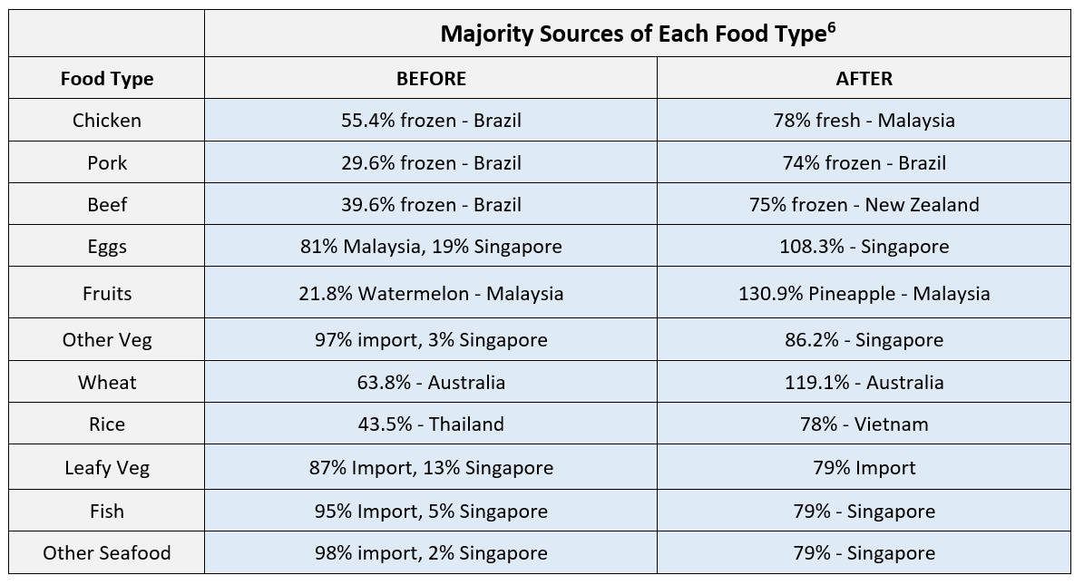
Special Mention
The model also calculated new import percentages for each food type :
Beef, eggs, other veg, fish and other seafoods should be sourced from closer countries
Other vegetables, fish and eggs recommended to be mainly locally produced.
Some % increased to >100% → pineapple, wheat and eggs
Feasible results?

Slide 13
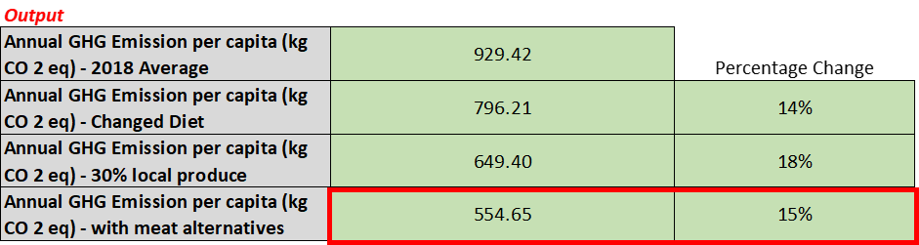
Scenario 2: Scenario 1 + Alternative Meats
Input Model (2018)
Baseline Model (Optimal Health)
Scenario 1 – Optimal Health + 30 by 30
Scenario 2 – Scenario 1 + Alternative Meats
How does replacing meats impact GHG emissions?
(1) Plant-based meat, or (2) cultivated meat, or (3) insects
For the baseline model, the calculated GHG emissions was 554.65 kg CO2-eq
→ Further 15% decrease from Scenario 1!
% of meats substituted was toggled to calculate GHG emissions

Slide 14
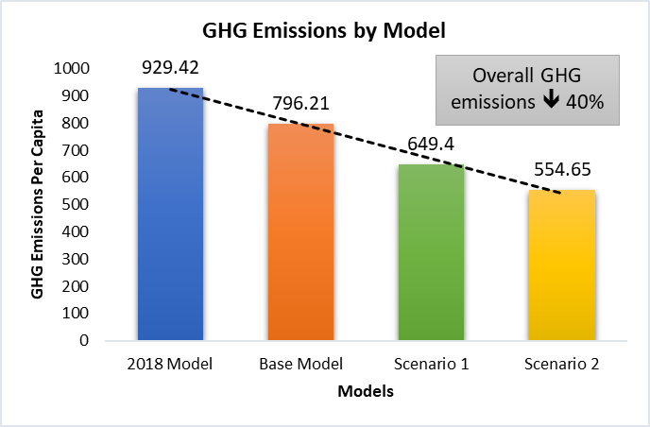
Model Comparison
Input Model (2018)
Baseline Model (Optimal Health)
Scenario 1 – Optimal Health + 30 by 30
Scenario 2 – Scenario 1 + Alternative Meats
Changing parameters such as diet, food production policy, and meat substitutes can lead to an overall reduction of 40% in GHG emissions!

Slide 15
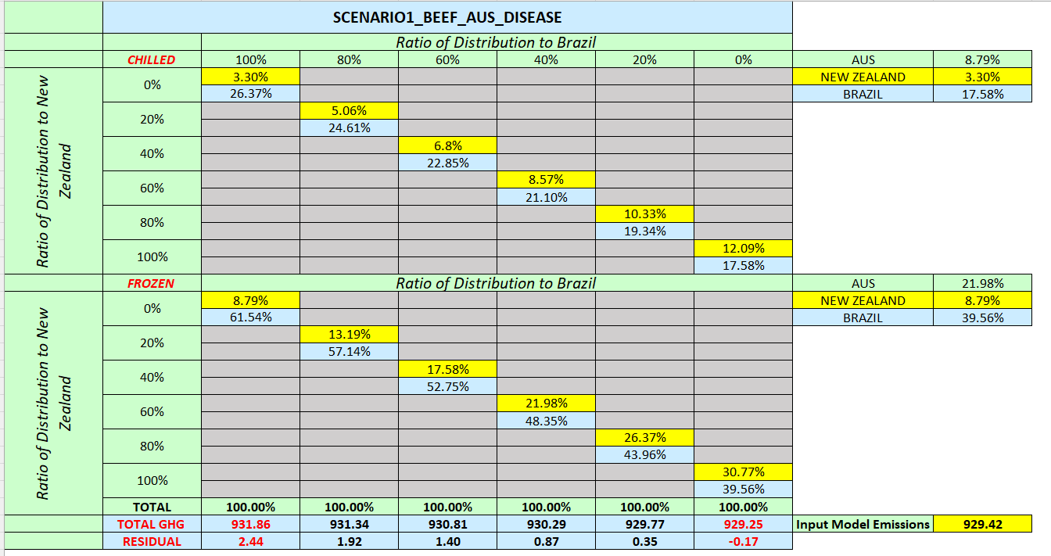
Sensitivity Analysis
What will happen if 1 or more country is removed as an exporter of beef due to bovine disease?
Beef → Highest GHG emissions of all the meats
Import countries: Brazil, Australia, NZ (lowest GHG per kg)
2 test cases
Assume Aus is unable to export
Assume Brazil is unable to export
New sources of chilled and frozen beef → NZ and the other country

Slide 16
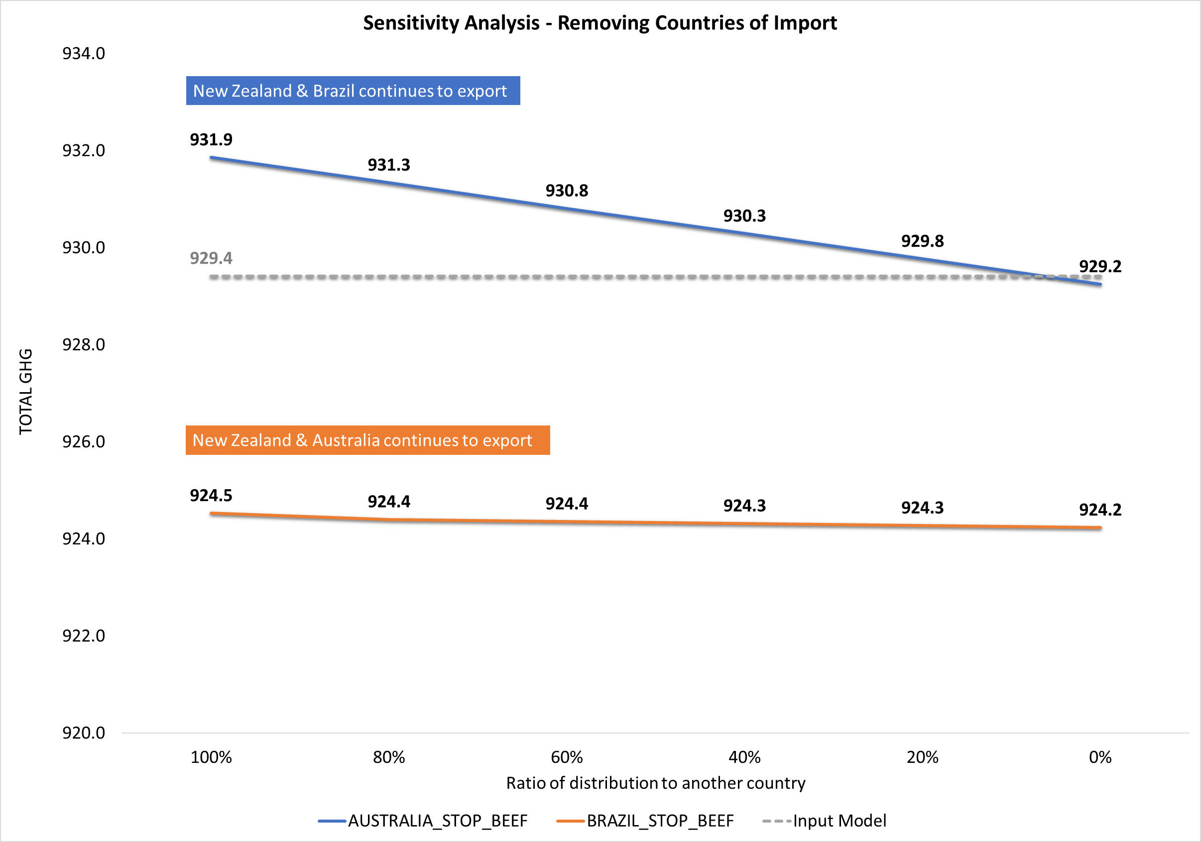
Sensitivity Analysis
What will happen if ≥1 country is removed as an exporter of beef due to bovine disease?
When Australia stops export → Noticeable decrease in GHG emissions based on the distribution of import ratios (↑ in GHG when Brazil takes on 100% of imports)
When Brazil stops export → GHG emissions are lower (-4.89kg CO₂-eq as compared to the input model)
Brazil’s contribution to GHG emissions is considerable, as removing it reduces the GHG emissions more vs Australia
In the event of bovine disease in Australia, New Zealand would be the preferred option to completely replace Australia’s export

Slide 17
Conclusion
What do our results indicate?
Dietary choices are related to environmental sustainability in terms of greenhouse gas emissions
Limitations
Alternative dietary choices may be environmentally beneficial, but does not mean beneficial for our human health
Significance of models in ↓ GHG emissions: Meat alternatives → Local food produce → HPB optimal diet
Excludes factors such as pricing of food items, which is key in determining Singapore’s selection of countries for import of key food items
Modelling highlights only 1 best source of food import for the lowest GHG emission, and not a range of ideal sources
Dietary choices are influenced by factors such as culture, nutritional knowledge, price, and availability → Imperative to consider all if we are to advocate for changes in food consumption patterns
Notes:
There are a few possible levers which can be leveraged on in terms of having an impact on GHG, and at the end of the day, it’s up to the relevant stakeholders to make an informed decision.

Slide 18
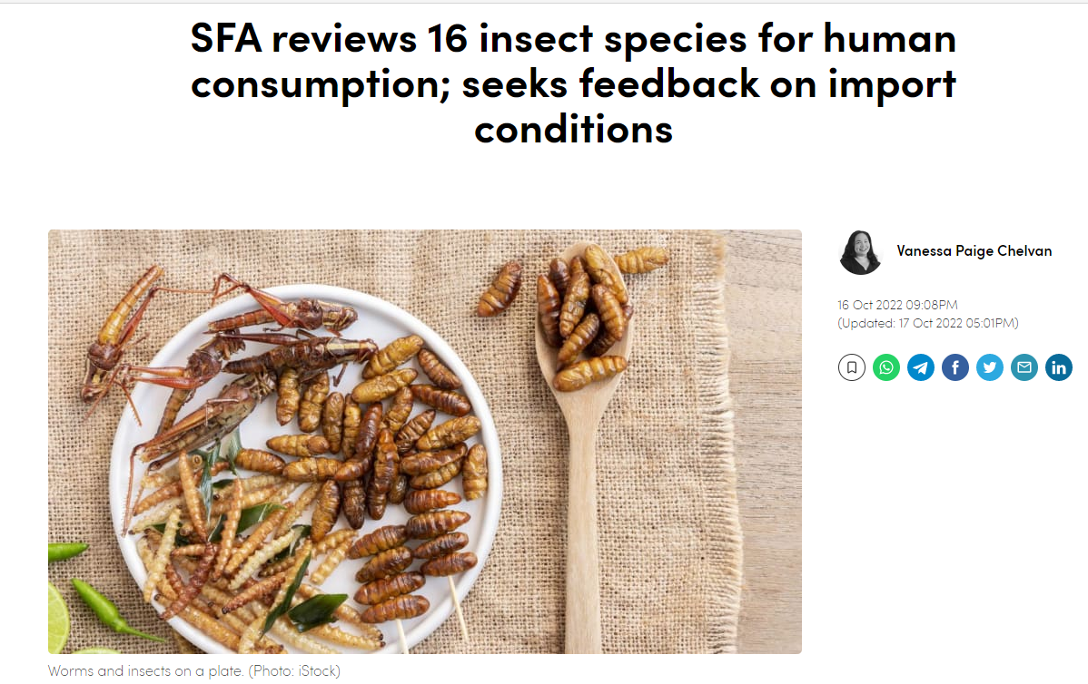
A glimpse of the future…
Thank you!

